Slide 1
Answering Tough Kid Questions and Alleviating Fears Surrounding COVID-19
Stephanie S. Fredrick, Ph.D., NCSP
Assistant Professor of School Psychology
Abbey McClemont, B.A.
School Psychology Doctoral Student

Slide 2
Overview
Typical and Atypical Responses to COVID-19
Talking About COVID-19
Strategies to Promote Youth Well-Being and Managing Anxiety
Resources
Questions

Slide 3
Typical and atypical responses to covid-19

Slide 4
Typical Responses to COVID-19
Preschool- Bad dreams, thumb sucking, change in appetite, increased temper tantrums, clinging to parents, bed-wetting, constipation, unexplainable aches or pains
School age- Nightmares, poor concentration, forgetfulness, whining, aggressive behavior, loss of interest, attention-seeking behavior, headaches, stomachaches
Teenagers- sleep disturbance, appetite disturbance, decrease in energy, agitation, excessive sadness or worry, avoidance of preferred activities, self-isolating behavior, ignoring health-promotion choices
(The National Child Traumatic Stress Network, 2020; Substance Abuse and Mental Health Services Administration, 2020; National Association of School Psychologists, 2020)

Slide 5
Signs Additional Support Might be Necessary
If behavioral and emotional reactions persist over time or worsen
Risk Factors:
Pre-existing mental health problems
Prior traumatic experiences
Prior abuse
Family conflict
Loss of a loved one
Substance misuse
(Substance Abuse and Mental Health Services Administration, 2020; The Child Trauma Training Center, 2020)

Slide 6
Resources for children and teens

Slide 7
Mental Health Services in WNY
Best Self Behavioral Health Offices
http://www.bestselfwny.org
716-884-0888
Gateway Longview- Behavioral Health Clinic
https://www.gateway-longview.org/
716-783-3221
Endeavor Health Services
https://www.ehsny.org/
716-895-6701
Horizon Health Services
https://www.horizon-health.org/services/overview/
716-831-1800

Slide 8
Mental Health and Crisis Support Hotlines
NYS COVID-19 Emotional Support Helpline
844-863-9314
Crisis Services of Erie County - Kids’ Helpline
716-834-1144
Spectrum C.A.R.E.S Crisis Call Line
716-882-4357
Crisis Text Line
Text HOME to 741741
National Suicide Prevention Lifeline
1-800-273-8255
The Trevor Project for LGBTQ+ Youth
1-866-488-7386
Text START to 678678
Suicide Hotline for Spanish Speakers
1-888-628-9454

Slide 9
Talking about covid-19

Slide 10
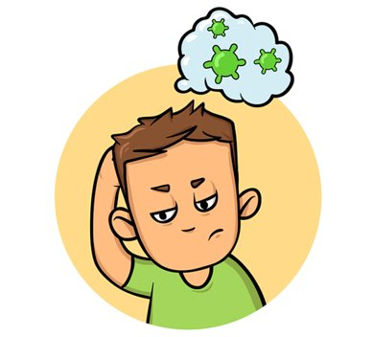
Tough Questions
When can I go back to school?
Will (insert important event here) get cancelled?
Will I get sick?
Will (insert important person) get sick?
What is COVID-19?
Why can’t I see my friends?

Slide 11
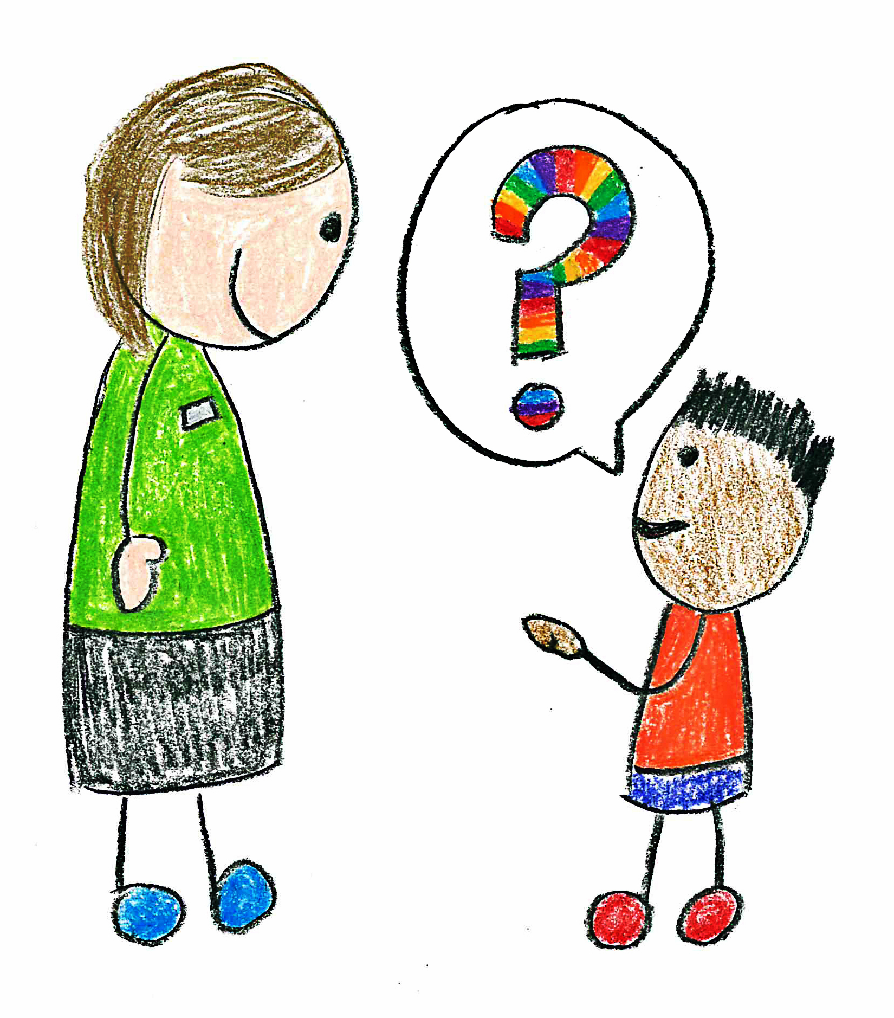
Follow Your Child’s Lead
Let their questions/concerns be your guide
It’s okay not to talk about it!
Check in/look for signs of distress if they are not asking questions

Slide 12
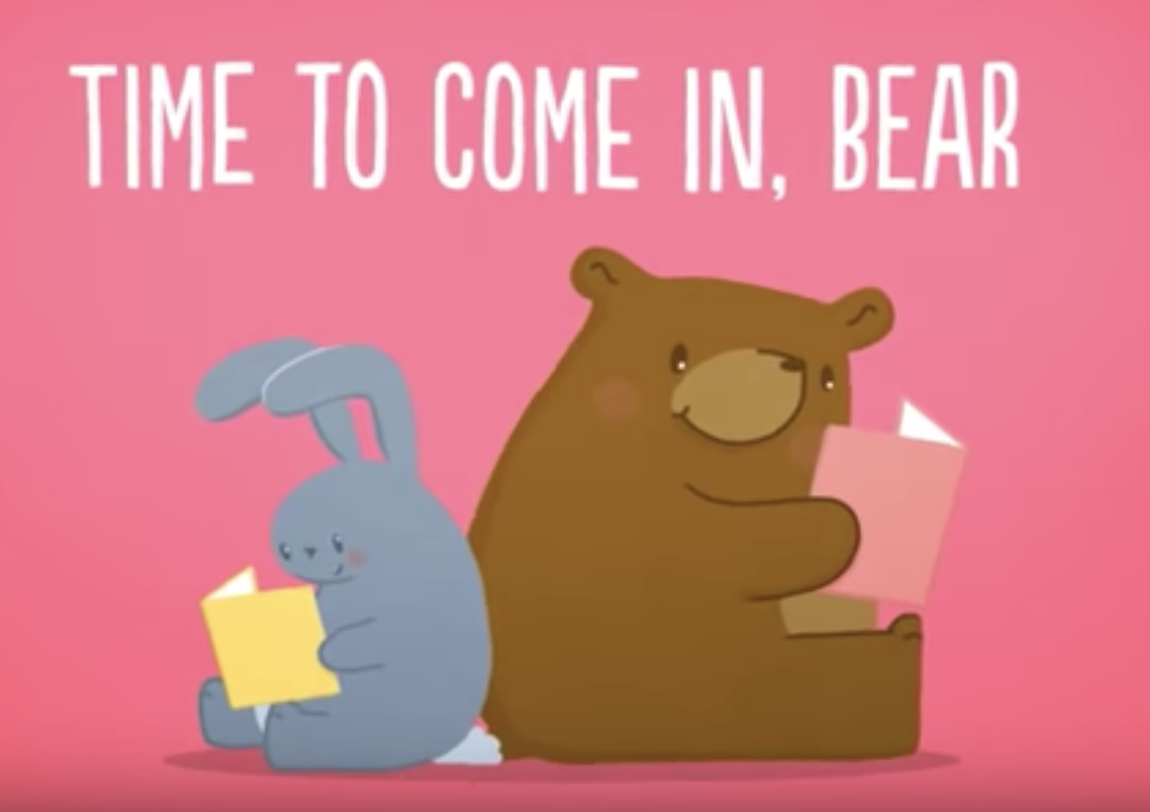
Talking with Young (Preschool & Early Elementary) Children
Revolve conversations around staying healthy and free of "germs”
Remind/explain simple safety steps
Time to Come In, Bear (Social Distancing Story)
https://www.youtube.com/watch?v=DA_SsZFYw0w&feature=youtu.be

Slide 13
Talking with Young (Preschool & Early Elementary) Children
May see themes of doctors and being sick in play
If possible, turn off TV/Computers/Smart Speakers
Social story with drawing/writing activities
https://susanguttridge.files.wordpress.com/2020/03/anagomez_oysterandthebutterflymar312020.pdf
https://www.youtube.com/watch?v=eCLmK8L05XI

Slide 14
Active Listening with Young Children
CDC Tips for Active Listening with Young Children (with examples!):
Make eye contact/stop doing other things
Physically get down on their level
Reflect or repeat back what they are saying and feeling
https://www.cdc.gov/parents/essentials/communication/activelistening.html

Slide 15
Older Elementary/Middle School
This age group may be more vocal in asking questions
Find out what they know:
What have you heard about the coronavirus?
Where did you hear about it?
What are your major concerns or worries?
What questions do you have that I can help answer?
How are you feeling about the coronavirus?
Validate feelings and concerns – then provide reassurances

Slide 16
Older Elementary/Middle School
Explain efforts at national/state/community level to keep germs from spreading
Keep them informed with what they need to know (e.g., local playground closed)
No need to share statistics/health repercussions

Slide 17
COVID-19
Children's Hospital Colorado Interview
https://www.youtube.com/watch?v=vSsKQPqpS7A#action=share
Time for Kids Interview and Articles
https://www.timeforkids.com/g56/ask-the-expert-katz/
https://www.timeforkids.com/g2/staying-healthy-4/
https://www.timeforkids.com/g56/news-from-our-readers/
BrainPOP
https://www.brainpop.com/health/diseasesinjuriesandconditions/coronavirus/
NPR comic
https://www.npr.org/sections/goatsandsoda/2020/02/28/809580453/just-for-kids-a-comic-exploring-the-new-coronavirus

Slide 18
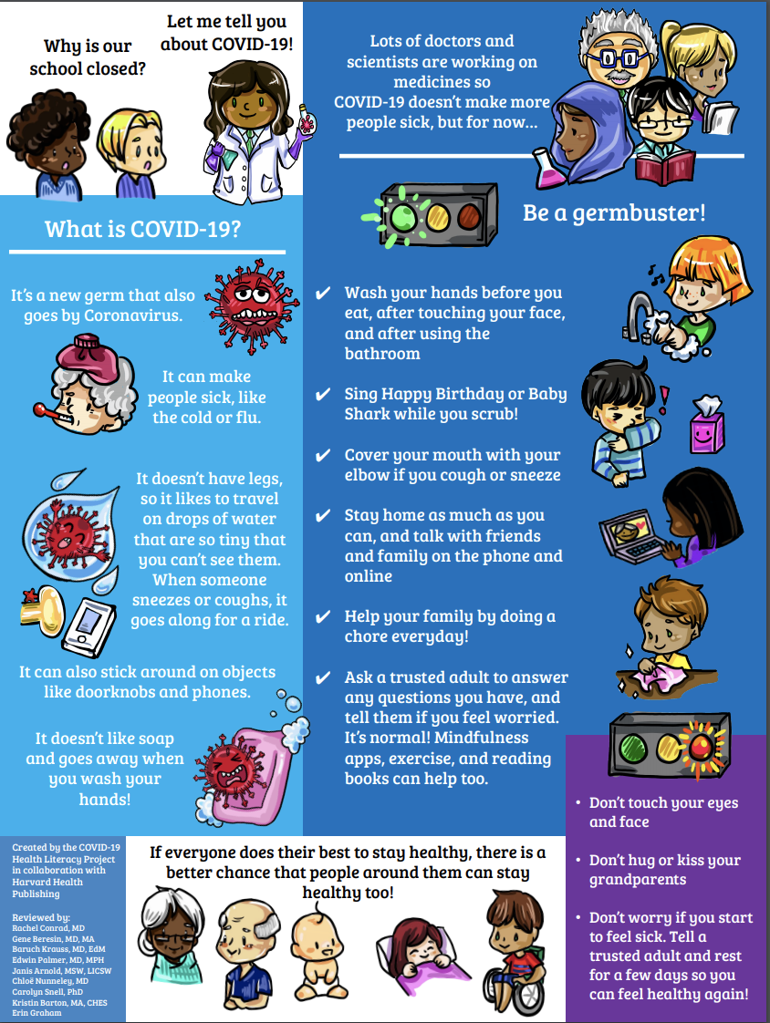
Created by the COVID-19 Health Literacy Project in collaboration with Harvard Health
Publishing
https://drive.google.com/file/d/1Az2n7Xa1f_GTJApr5gFvlcanOggWcCWq/view
​
​
​

Slide 19
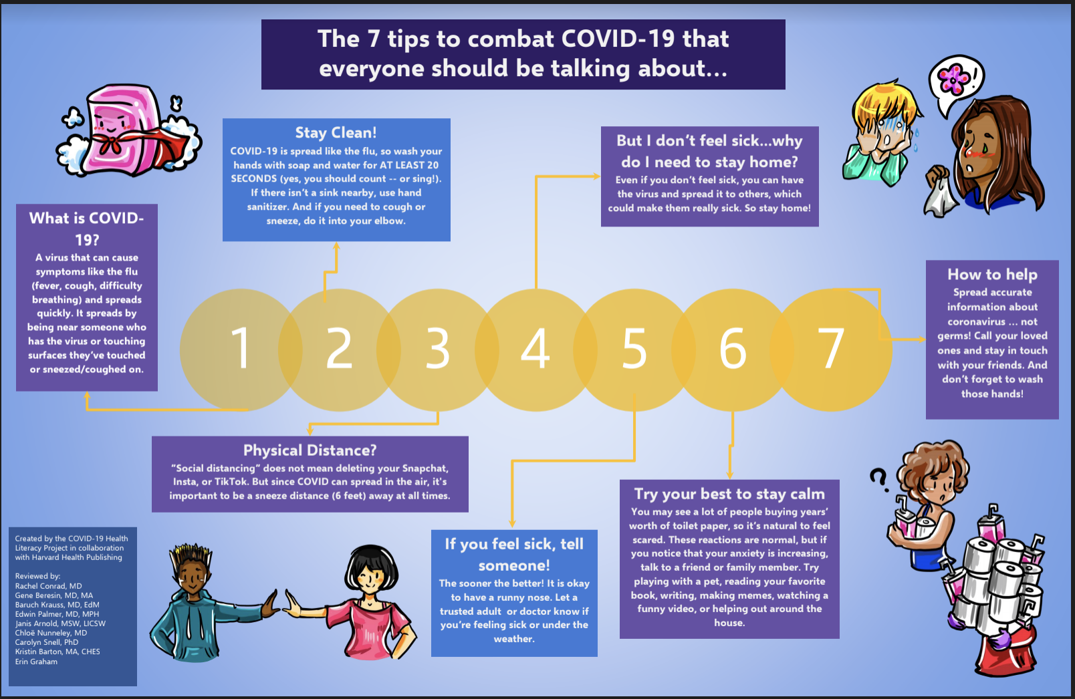
https://drive.google.com/file/d/1JfBNSJRusjwWwWq9EXhncrhkBkBun0FT/view

Slide 20
Social Distancing
Following the guidelines of the health experts and state leaders
“Staying away from others to reduce the risk of getting sick”
CBC Kids News:
https://www.youtube.com/watch?v=ZqWrPWmeDK4
Time for Kids:
https://www.timeforkids.com/g56/social-distancing-2/

Slide 21
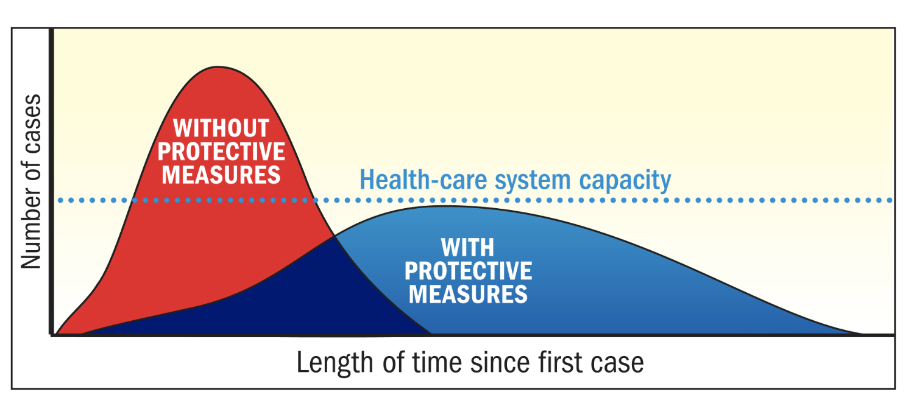
Flattening the Curve
https://www.timeforkids.com/g34/flattening-the-curve/

Slide 22
Teenagers
Issues can be discussed in more depth
Discuss appropriate sources for COVID-19 facts (e.g., CDC, WHO, NYS Department of Health)
Give them space to vent
Don’t be afraid to “let them be”

Slide 23
Paradox of Pandemics
https://www.youtube.com/watch?v=fgBla7RepXU
(PBS It’s Okay to be Smart)

Slide 24
Across All Ages…
Be honest and accurate
Clarify any misunderstandings
Make sure they know you are open to questions anytime
Explain/remind (simple) safety steps
Try to be extra patient and forgiving – I know this is hard!

Slide 25
Strategies to promote youth well-being and managing anxiety

Slide 26
Managing Your Own Behavior and Responses
Be aware of your facial expressions, your words, and the intensity of your emotions
Lower your expectations (for yourself and those around you)
…stay safe and sane
Connect with other working parents

Slide 27
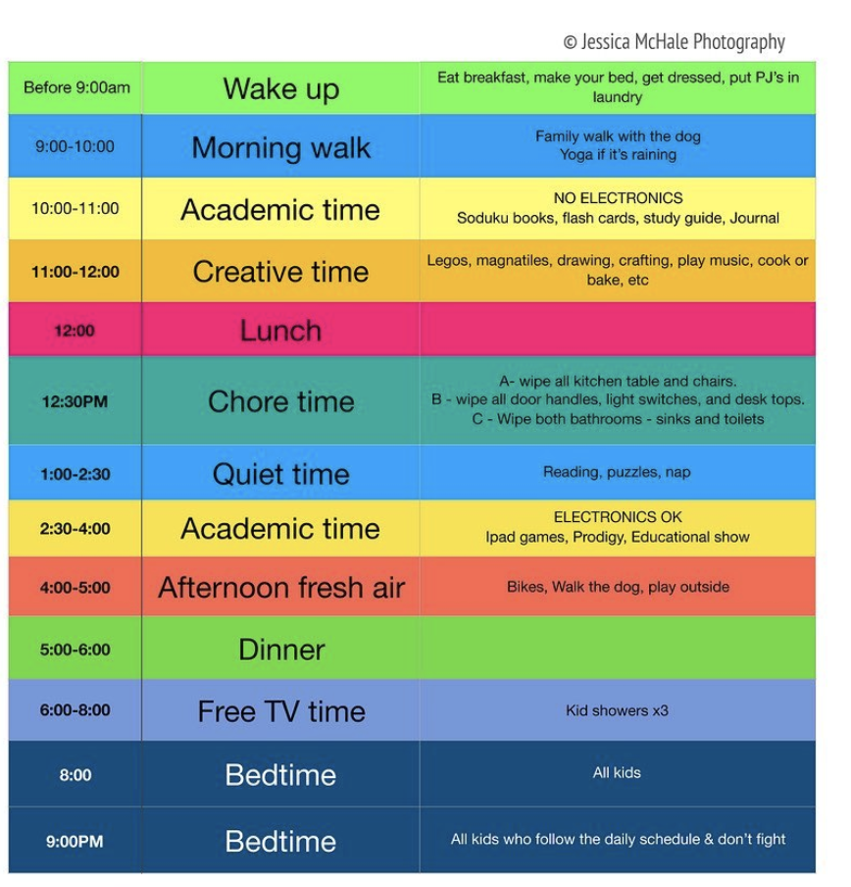
Maintain Routines
As much as possible (be kind to yourself)
Regular meal and bedtimes
Visual/written schedule
Use timers to help with transitions (or get off screens)
Teens – let them create their own schedule or be involved in creating family schedules

Slide 28
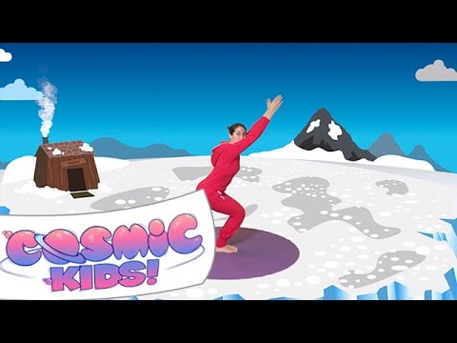
Exercise
Daily walk/bike ride, yoga, obstacle course, hide and seek, exercise video, dancing, family game
Try to incorporate it into your daily schedule
Apps/Websites/Games for Movement:
https://www.commonsensemedia.org/lists/movement-apps-games-and-websites

Slide 29
Limit News Coverage
Try to limit access to news coverage
Watch news with them
Try not to let pandemic conversations take over

Slide 30
Social Connection
Social Distancing Social Isolation

Slide 31
Teenagers and Social Media
Friends are important sources of social support and normalcy during this time
Online gaming can be a form of socialization
Watch out for social media challenges
(Siddiqui & Singh, 2016; Carroll & Kirkpatrick, 2011)

Slide 32
Self-Regulation: Mindfulness and Meditation
Daniel Tiger’s Neighborhood
https://pbskids.org/video/
Sesame Street
https://pbskids.org/video/sesame-street/2365835531
Meditation Apps:
https://www.commonsensemedia.org/lists/meditation-apps-for-kids
(Black et al., 2015; Cook-Cottone, 2017; Modi et al., 2018)

Slide 33
Improve Self Efficacy and Promote Helping
Health-Focused Apps
Preschool and School-Age
https://www.commonsensemedia.org/lists/best-health-apps-and-games-for-kids
Breathe, Think, Do Sesame
Dr. Panda Bath Time
My Food-Nutrition for Kids
HappiMe
Stop, Breathe, Think Kids
Tweens/Teens
https://www.commonsensemedia.org/lists/apps-to-help-with-mental-health
*See handouts on how to help and give back in WNY

Slide 34
Focus on the Positives…

Slide 35
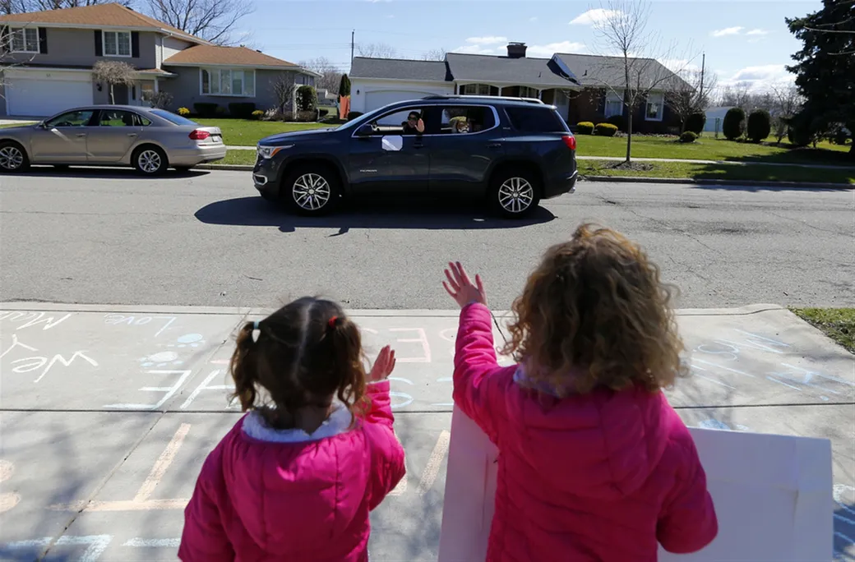
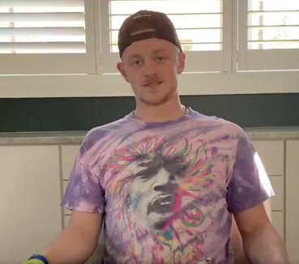
And the helpers…

Slide 36
Resources
American Psychological Association
https://www.apa.org/practice/programs/dmhi/research-information/pandemics
BrainPOP
https://www.brainpop.com/health/diseasesinjuriesandconditions/coronavirus/
CBC Kids News
https://www.cbc.ca/kidsnews/
Center for Disease Control and Prevention
https://www.cdc.gov/coronavirus/2019-ncov/daily-life-coping/managing-stress-anxiety.html?CDC_AA_refVal=https%3A%2F%2Fwww.cdc.gov%2Fcoronavirus%2F2019-ncov%2Fprepare%2Fmanaging-stress-anxiety.html
Child Mind Institute (Twice daily Facebook live video chats, M-F 10am & 4:30pm ET)
https://childmind.org/coping-during-covid-19-resources-for-parents/
Common Sense Media
https://www.commonsensemedia.org/
https://www.commonsensemedia.org/blog/help-your-family-de-stress-during-coronavirus-uncertainty

Slide 37
Resources
The Clay Center for Young Healthy Minds
https://www.mghclaycenter.org/
National Association of School Psychologists (NASP)
https://www.nasponline.org/resources-and-publications/resources-and-podcasts/covid-19-resource-center
National Child Traumatic Stress Network
https://www.nctsn.org/
Time for Kids (follow on social media for updated stories)
https://www.timeforkids.com/

Slide 38
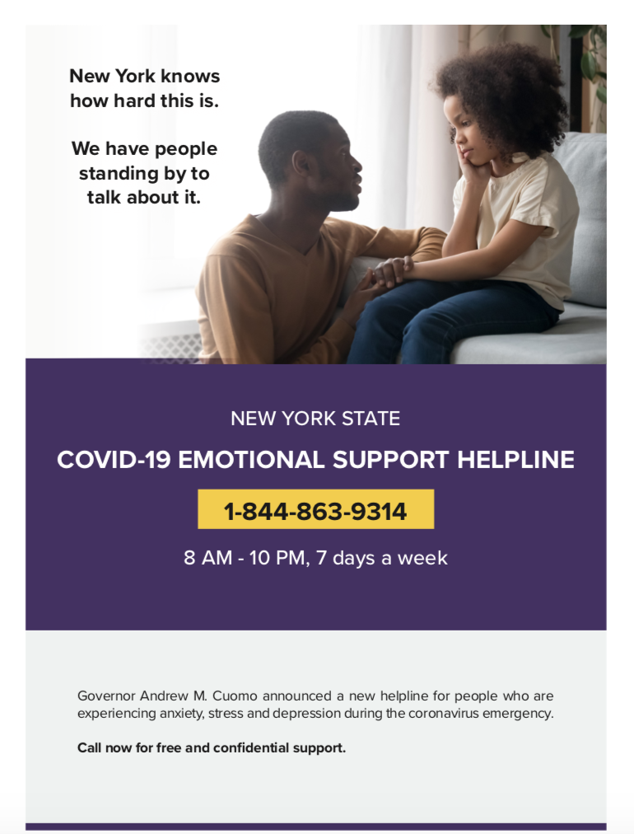

Slide 39
Thank you! Questions?
Stephanie Fredrick, Ph.D., NCSP
Associate Director, Alberti Center for Bullying Abuse Prevention
Assistant Professor, Counseling, School, and Educational Psychology
Graduate School of Education
716-645-1141
ssfredri@buffalo.edu
Abbey McClemont, B.A.
Doctoral Student
Combined Counseling and School Psychology Program
Graduate School of Education

